Slide 1
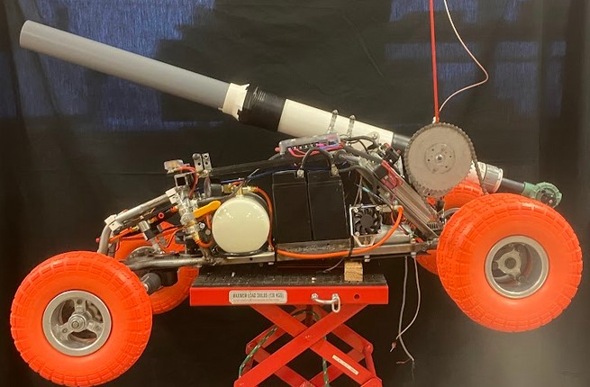
The ATV Project
By:Xavier Hoskins-Team Lead And Baden Brenner-Team Member

Slide 2
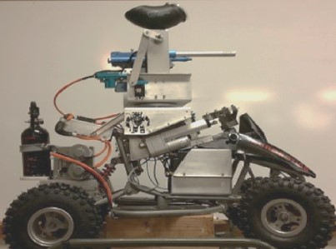
Overview
This is the Fourth iteration of the Project
This iteration includes
Chassis and frame Changes
Improved Drive and Steering systems
Pneumatic Nerf Cannons
Onboard Air system with air Compressor

Slide 3
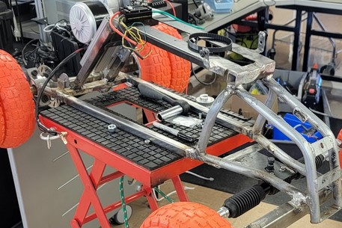
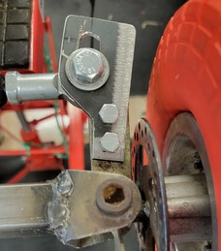
Chassis Fabrication

Slide 4
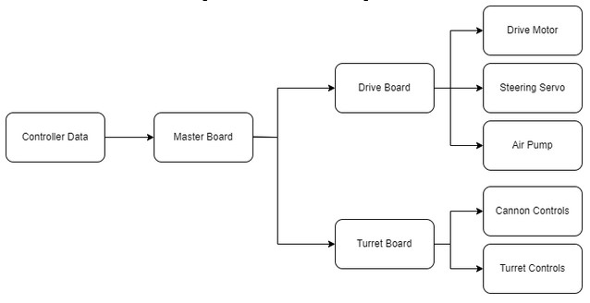
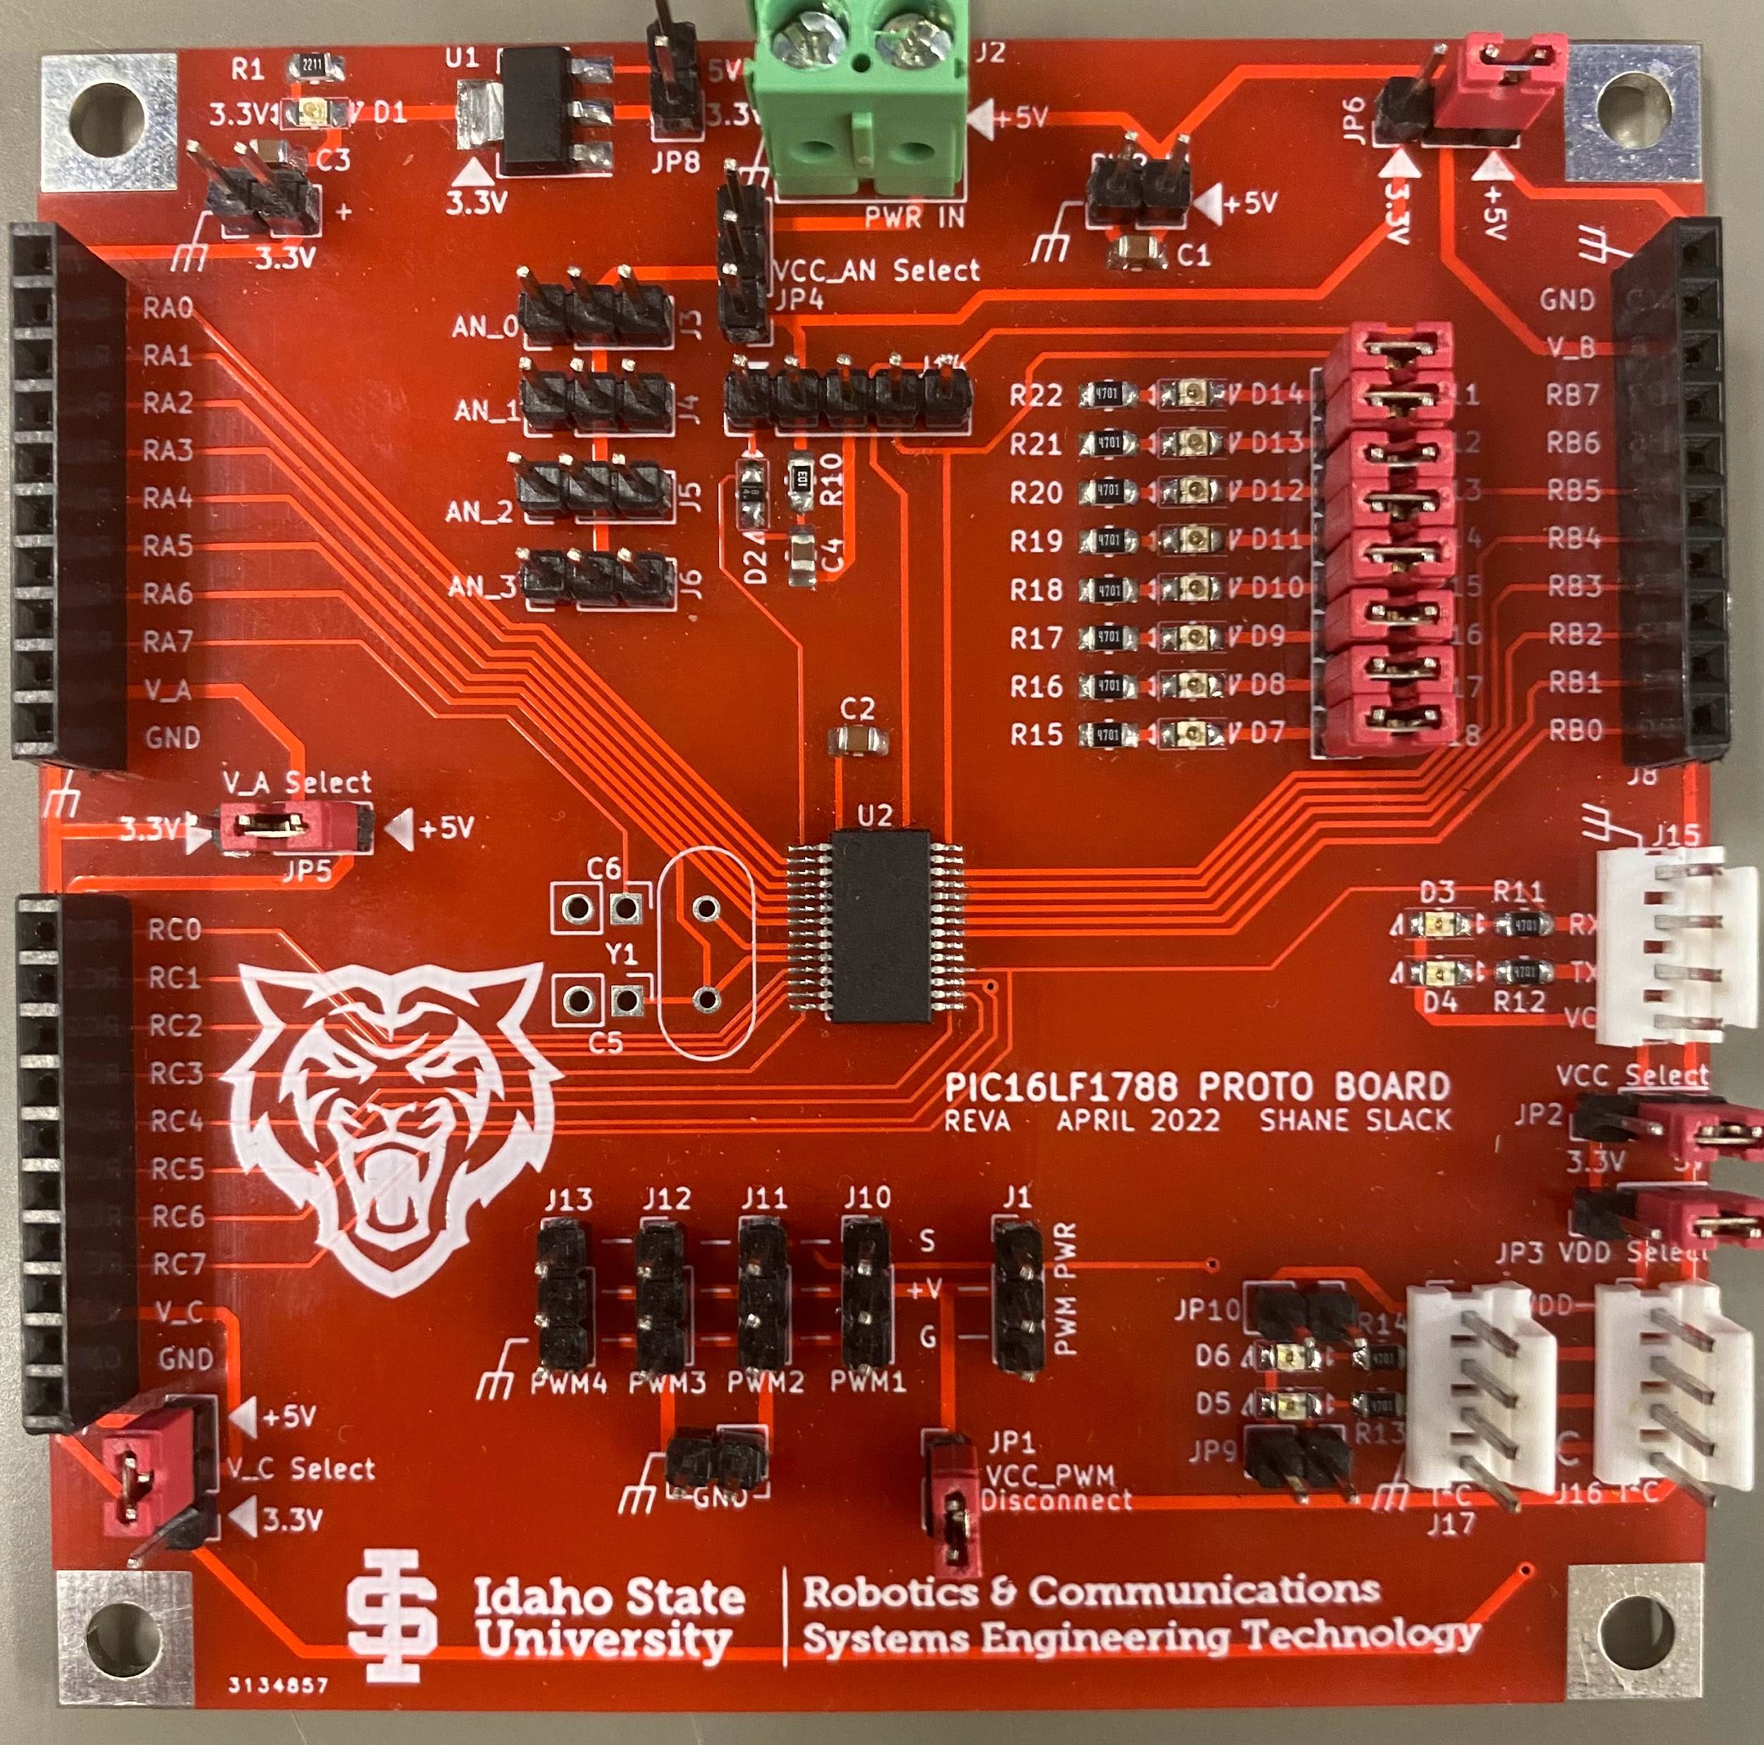
System Overview

Slide 5
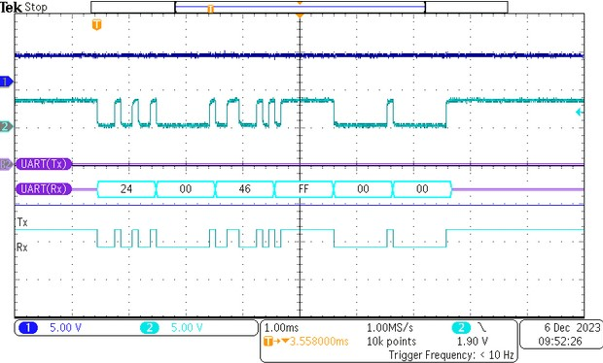
Master Board Operation
Receives data through UART
Validates the Sync byte
Sends data through I2C

Slide 6
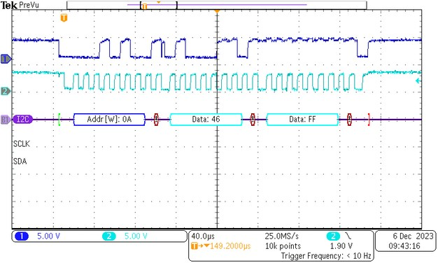
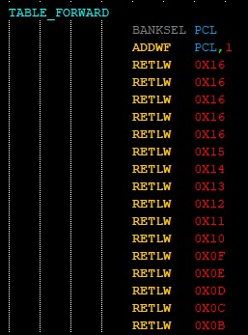
Drive Board Operation
Receives I2C Data and Controls PWM Outputs

Slide 7
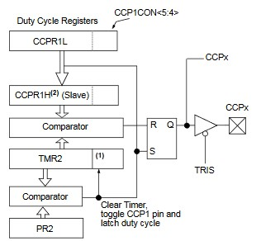
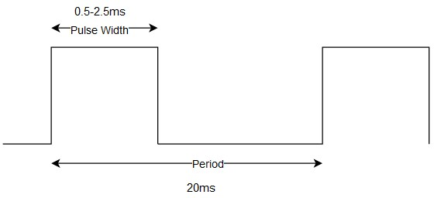
PWM Operation
The Period is set using timer2 and the PR2 register
Pulse Width is set with the CPPRxL and bits 4,5 of the CCPxCON

Slide 8
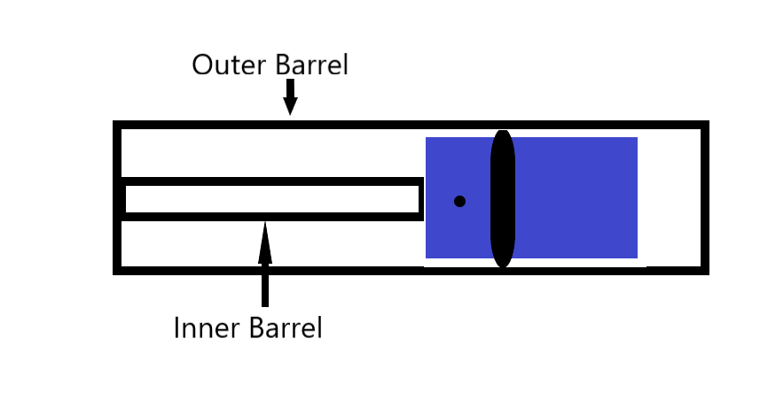
Air Cannon
Piston driven system
High pressure, high speed system

Slide 9
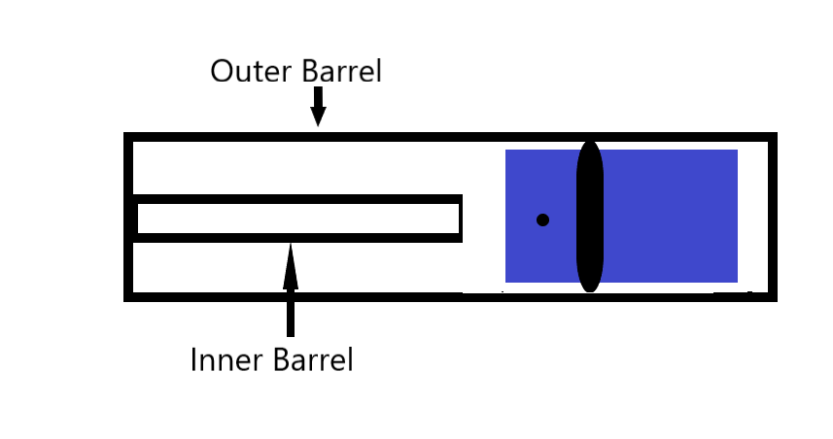
Air Cannon

Slide 10
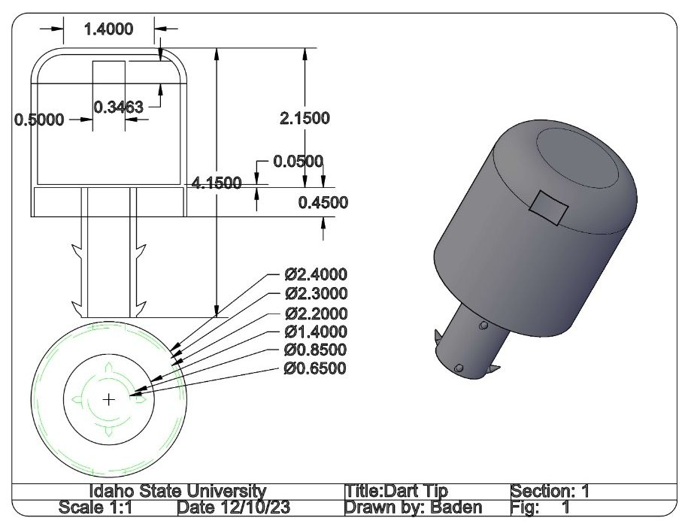
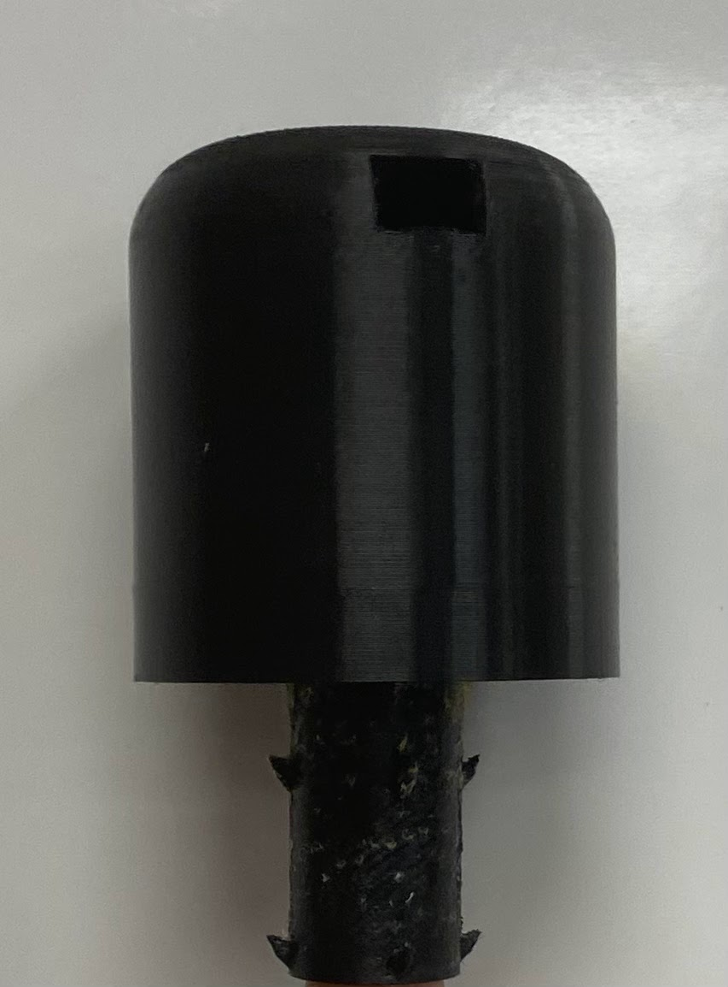
Nerf Dart

Slide 11
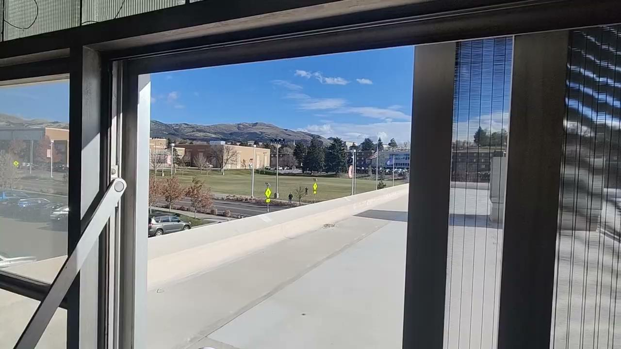

Slide 12
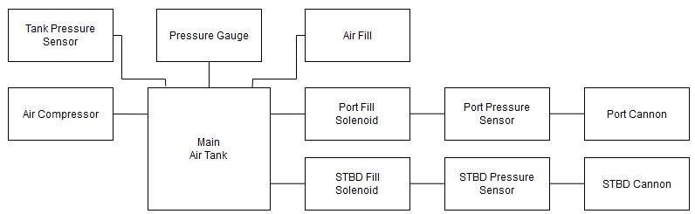
Air System

Slide 13
Recommendations
Higher Volume Air Compressor
Larger Air Tanks
Custom Control Boards
More Streamlined Wiring Harness
Finalize the Cannon and Turret Systems
Additional Sensors

Slide 14
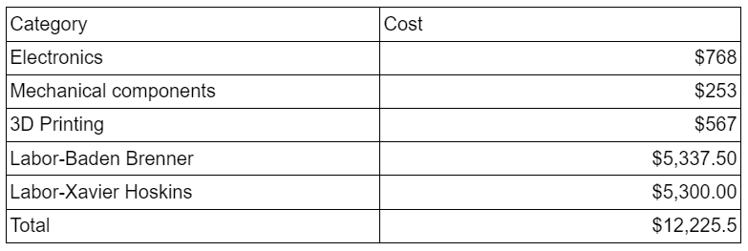
Cost Analysis

Slide 15
Questions?

